Slide 1

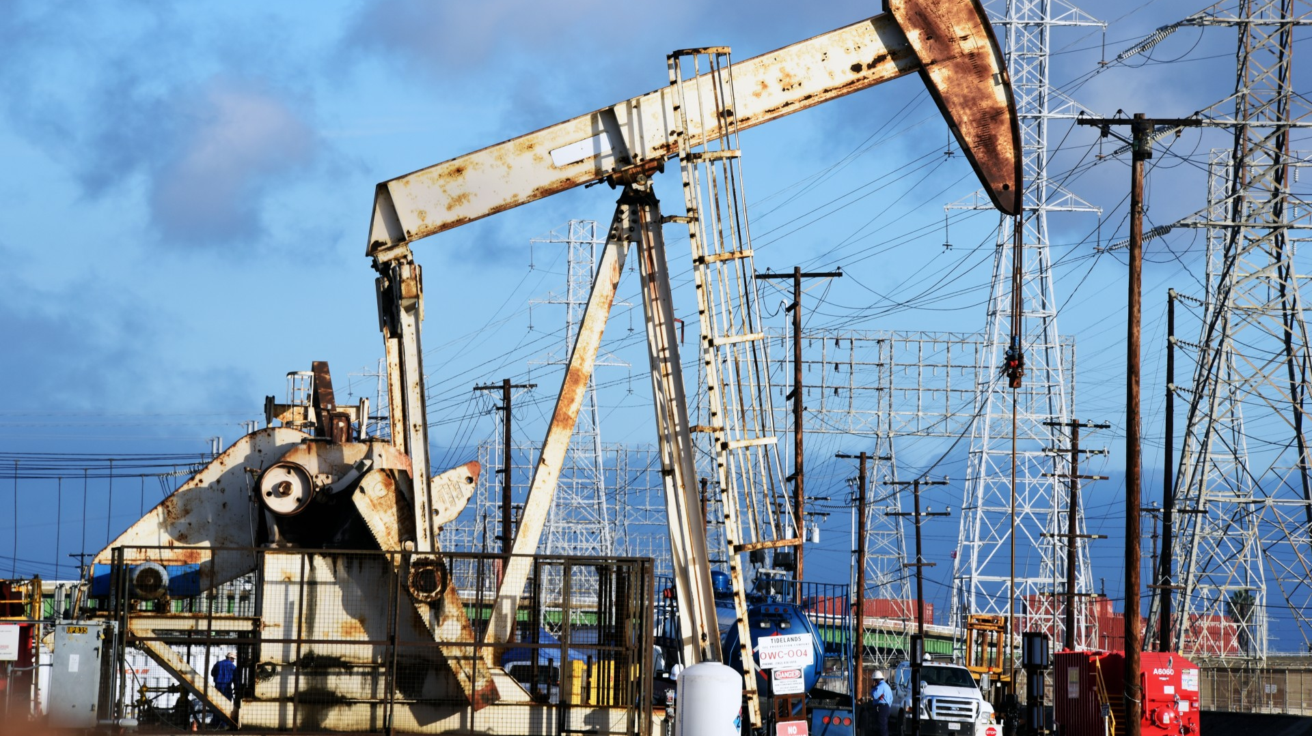
Demand and supply of oil and gas
By
Sufiyaan Usmani
K21-3195

Slide 2

Introduction
Oil is the crown jewel of commodities that is used in a multitude of ways in our lives, from plastics to asphalt to fuel.
Changes in oil prices can send shockwaves throughout the global economy.
Every movement on the production and consumption side of oil is reflected in the price.
Oil prices are determined by global supply and demand.
Growing economies increase demand for energy in general and especially for transporting goods and materials from producers to consumers.

Slide 3
Top 10 oil producing countries
 | COUNTRY | OIL PRODUCTION (bbl/day)
1 | United States | 11,307,560
2 | Russia | 9,865,495
3 | Saudi Arabia (OPEC) | 9,264,921
4 | Canada | 4,201,101
5 | Iraq (OPEC) | 4,102,311
6 | China | 3,888,989
7 | United Arab Emirates (OPEC) | 3,138,249
8 | Brazil | 2,939,950
9 | Iran (OPEC) | 2,665,809
10 | Kuwait (OPEC) | 2,625,145

Slide 4
Top 10 oil consuming countries
 | COUNTRY | OIL CONSUMPTION (bbl/day)
1 | United States | 19,400,000
2 | China | 14,225,000
3 | India | 5,271,000
4 | Japan | 3,812,000
5 | Saudi Arabia | 3,788,000
6 | Russia | 3,317,000
7 | South Korea | 2,760,000
8 | Canada | 2,403,000
9 | Brazil | 2,398,000
10 | Germany | 2,281,000

Slide 5
Comparative cost of production
COUNTRY | GROSS TAXES | CAPITAL SPENDING | PRODUCTION COSTS | ADMIN TRANSPORT | TOTAL
UK | $ 0 | $ 22.67 | $ 17.36 | $ 4.30 | $ 44.33
Brazil | $ 7 | $ 16.09 | $ 9.45 | $ 2.80 | $ 34.99
Nigeria | $ 4 | $ 13.10 | $ 8.81 | $ 2.97 | $ 28.99
Venezuela | $ 10 | $ 6.66 | $ 7.94 | $ 2.54 | $ 27.62
Canada | $ 2 | $ 9.69 | $ 11.56 | $ 2.92 | $ 26.64
Norway | $ 0 | $ 13.76 | $ 4.24 | $ 3.12 | $ 21.31
Indonesia | $ 2 | $ 7.65 | $ 6.87 | $ 3.63 | $ 19.71
Russia | $ 8.44 | $ 5.10 | $ 2.98 | $ 2.69 | $ 19.21
Iraq | $ 0.91 | $ 5.03 | $ 2.16 | $ 2.47 | $ 10.57
Iran | $ $0 | $ 4.48 | $ 1.94 | $ 2.67 | $ 9.08
Saudi Arabia | $ 0 | $ 3.50 | $ 3.00 | $ 2.49 | $ 8.98

